Slide 1

Social Buzz Analysis Presentation
MENU
ANALYSIS
CONTACT
Data ANALYSIS
Here is where your presentation begins
Subhajyoti Prusty
Data Analyst

Slide 2
Today’s Agenda
MENU
ANALYSIS
CONTACT
Data ANALYSIS
Project recap
Problem
Analytics team
Process
Insights
Summary

Slide 3
Project Recap
MENU
ANALYSIS
CONTACT
Social Buzz is a global unicorn technology company growing at an accelerated rate. Accenture has embarked in a 3 month work pilot to help tackle their biggest challenges which include:
Audit of Social Buzz Big data practice
Implementation of an IPO
Analysis of top 5 popular categories content

Slide 4
Problem
MENU
ANALYSIS
CONTACT
Data ANALYSIS
Social Buzz has reached over 100,000 posts per day which take us to 36,500,000 pieces of content per year!

Slide 5
The Analytics Team
Andrew fleming
Marcus Rompton
Subhajyoti prusty
MENU
ANALYSIS
CONTACT
Data ANALYSIS
Chef Technical Architect
Senior Data Expert
Data Analyst

Slide 6
Process
MENU
ANALYSIS
CONTACT
Data ANALYSIS
1 - Understanding Problem
2 - Data Extraction
3 - Data Cleaning
4 - Data Analysis
5 - Data Visualization to uncover insights

Slide 7
After carefully reviewing and understanding the project requirements, the CSV files were loaded into Excel followed by SAS for processing. Data cleaning was performed, missing values were handled, erroneous & duplicate entries were removed. The datasets reactions, reaction type, and content were merged based on key values prior the analysis, data visualization was carried out using Tableau software.
MENU
ANALYSIS
CONTACT
Data ANALYSIS

Slide 8
Insights
MENU
ANALYSIS
CONTACT
Data ANALYSIS
The analysis results shows 16 categories of
post across the entire dataset. There was
1969 animals posts alone telling us there are
lots of animals lover out there. The result also
shows January scored the highest number of
posts of 2218 which is interesting to see how
active people are even after the big holidays
season.
Unique Categories
16
Reactions to “Animals”
1969
Month with highest posts
January

Slide 9
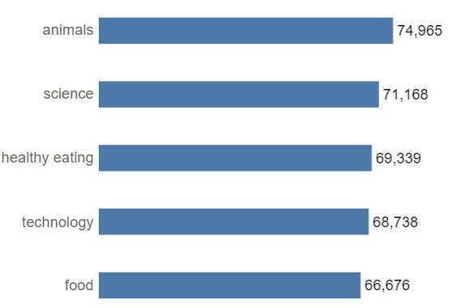
Top 5 Categories by popularity score
MENU
ANALYSIS
CONTACT
Data ANALYSIS
The top 5 most popular categories of content were animals, science, healthy eating, technology, and food. Animals had an aggregate popularity score of 74,965.
It's fascinating to see both animals and science within the top 5, this shows that people like seeing real-life content the most. No wonder healthy eating made it to the top 5 as many people are very keen when it comes to making healthy choices.

Slide 10
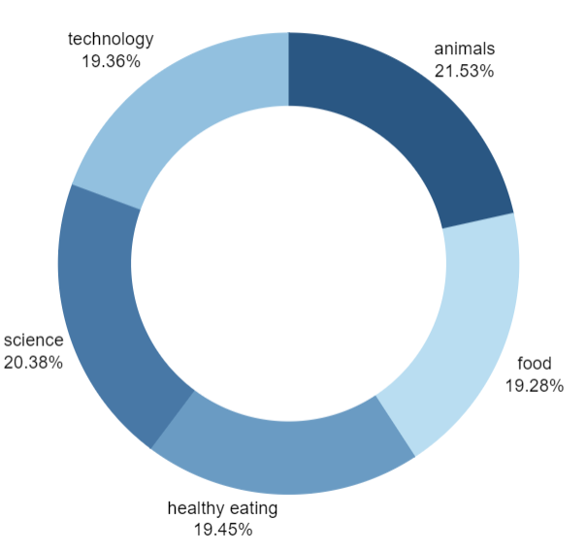
Top 5 Categories by popular Share
MENU
ANALYSIS
CONTACT
Data ANALYSIS
We can see that there isn't a big difference from the chart split between popularity of the top 5 categories. The first largest percentage animals outperformed the second largest one science by 1.1%.

Slide 11
Recommendations
MENU
ANALYSIS
CONTACT
Data ANALYSIS
Animals and science were two of the most popular content categories with healthy eating ranking as the third one. We recommend creating more content related to those categories to boost user engagements.
Healthy eating can be placed in the same category as "food". We suggest collaborating with healthy food brands to help bring brand awareness and to reach wider audience.
With this technology age, there is no surprise to see technology in top 5 categories. It shows that users enjoy tech contents. Collaborating through brands partnership with tech companies will definitely increase engagement rates.

Slide 12
MENU
ANALYSIS
CONTACT
Data ANALYSIS
As much as this analysis was insightful, we are ready to take it to the next stage and we have expertise within Accenture to help you realize these kinds of insights in production across your organization and in real time. We would love to help you with this.

Slide 13
Summary
MENU
ANALYSIS
CONTACT
Data ANALYSIS
ANALYSIS
Animals and science are the two most popular categories of content, showing that people enjoy "real-life" and "factual" content the most.
INSIGHT
Food is a common theme with the top 5 categories with "Healthy Eating" ranking the highest. This may give an indication to the audience within your user base. You could use this insight to create a campaign and work with healthy eating brands to boost user engagement.
NEXT STEPS
This ad-hoc analysis is insightful, but it's time to take this analysis into large scale production for real-time understanding of your business. We can show you how to do this.

Slide 14

Thank You! Any questions?
MENU
ANALYSIS
CONTACT
Data ANALYSIS

